Slide 1
Structure Programming
ICT-1105
Information and Communication Technology
Lecture-13
Date:

Slide 2
Class contents has given in Google Classroom with code
nhauiw4

Slide 3
ARRAYS

Slide 4
A data structure is the way data is stored in the machine and the functions used to access that data. An easy way to think of a data structure is a collection of related data items. An array is a data structure that is a collection of variables of one type that are accessed through a common name. Each element of an array is given a number by which we can access that element which is called an index. It solves the problem of storing a large number of values and manipulating them.

Slide 5
Array : Defination
An array is a group (or collection) of same data types.
Or
An array is a collection of data that holds fixed number of values of same type.
Or
Array is a collection or group of elements (data). All the elements of array are homogeneous (similar). It has contiguous memory location.
Or
An array is a data structured that can store a fixed size sequential collection of elements of same data type

Slide 6
What’s the need of an array?
Suppose you have to store marks of 50 students, one way to do this is allotting 50 variables. So it will be typical and hard to manage. For example we can not access the value of these variables with only 1 or 2 lines of code.
Another way to do this is array. By using array, we can access the elements easily. Only few lines of code is required to access the elements of array.

Slide 7
Where arrays are used
to store list of Employee or Student names
to store marks of a students
to store list of numbers or characters etc.

Slide 8
Advantage of C Array
Code Optimization: Less code to the access the data.
Easy to traverse data: By using the for loop, we can retrieve the elements of an array easily.
Easy to sort data: To sort the elements of array, we need a few lines of code only.
Random Access: We can access any element randomly using the array.

Slide 9
Disadvantage of Array
Fixed Size: Whatever size, we define at the time of declaration of array, we can't exceed the limit. So, it doesn't grow the size dynamically like LinkedList

Slide 10
Declaration of an Array
Syntax: (One Dimensional Array)
data_type array_name[size];
data_type represents the type of elements present in the array.
array_name represents the name of the array.
Size represents the number of elements that can be stored in the array.

Slide 11
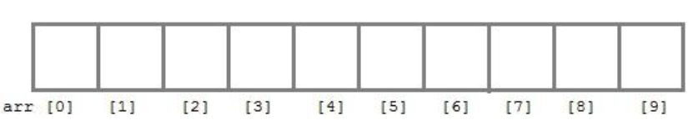
Declaration of an Array
For example:
int arr[10];

Slide 12
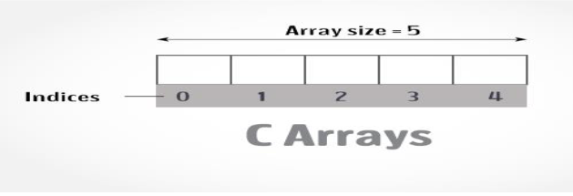
Declaration of an Array
For example:
int arr[5];
Here int is the data type, arr is the name of the array and 5 is the size of array. It means array arr can only contain 5 elements of int type. Index of an array starts from 0 to size-1 i.e first element of arr array will be stored at arr[0] address and last element will occupy arr[4].

Slide 13
Declaration of an Array
For example:
int age[100];
float sal[15];
char grade[20];
Here age is an integer type array, which can store 100 elements of integer type. The array sal is floating type array of size 15, can hold float values. Grade is a character type array which holds 20 characters.

Slide 14
Initialization of an Array
Syntax:
data_type array_name[size]={value1, value2,……..valueN};
Value1, value2, valueN are the constant values known as initializers, which are assigned to the array elements one after another.

Slide 15
Initialization of an Array
Example:
int marks[5]={10,2,0,23,4};
The values of the array elements after this initialization are:
marks[0]=10,
marks[1]=2,
marks[2]=0,
marks[3]=23,
marks[4]=4

Slide 16
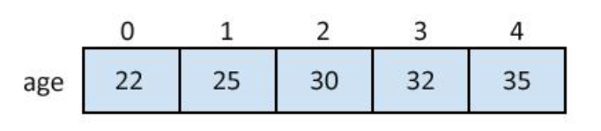
Initialization of an Array
Example:
int age[5]={22,25,30,32,35};
int marks[4]={ 67, 87, 56, 77 }; //integer array initialization
float area[5]={ 23.4, 6.8, 5.5 }; //float array initialization
int marks[4]={ 67, 87, 56, 77, 59 }; //Compile time error

Slide 17
Different ways of initializing arrays
1 : Initilizing all specified memory locations
2 : Partial array initialization.
3 : Intilization without size.
4 : String initialization.

Slide 18
1 : Initilizing all specified memory locations :
If the number of values to be initialized is equal to size of array. Arrays can be initialized at the time of declaration. Array elements can be initialized with data items of type int,float,char, etc.
Ex : consider integer initialization
int a[5]={10,20,30,40,50};

Slide 19
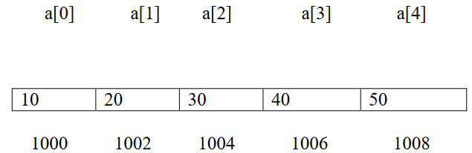
1 : Initilizing all specified memory locations :
During compilation, 5 contiguous memory locations are reserved by the compiler for the variable a and all these locations are initialized. The array a is initialized as
If the size of integer is 2 bytes, 10 bytes will be allocated for the variable a.

Slide 20
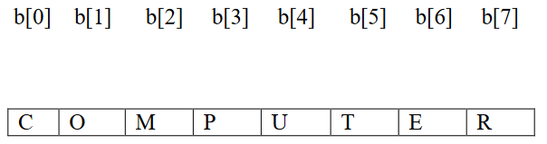
1 : Initilizing all specified memory locations :
Ex : consider character initialization
char b[8] = {‘C’, ‘O’, ‘M’, ‘P’, ‘U’, ‘T’, ‘E’, ‘R’};
The array b is initialized as

Slide 21
1 : Initilizing all specified memory locations :
Other Examples :
char b[5]={‘J’, ‘B’, ‘R’, ‘E’, ‘C’, ‘B’};
//error : number of initial values are more than the size of array.
int a[5]={10,20,30,40,50,60};
//error : number of initial values are more than the size of array.

Slide 22
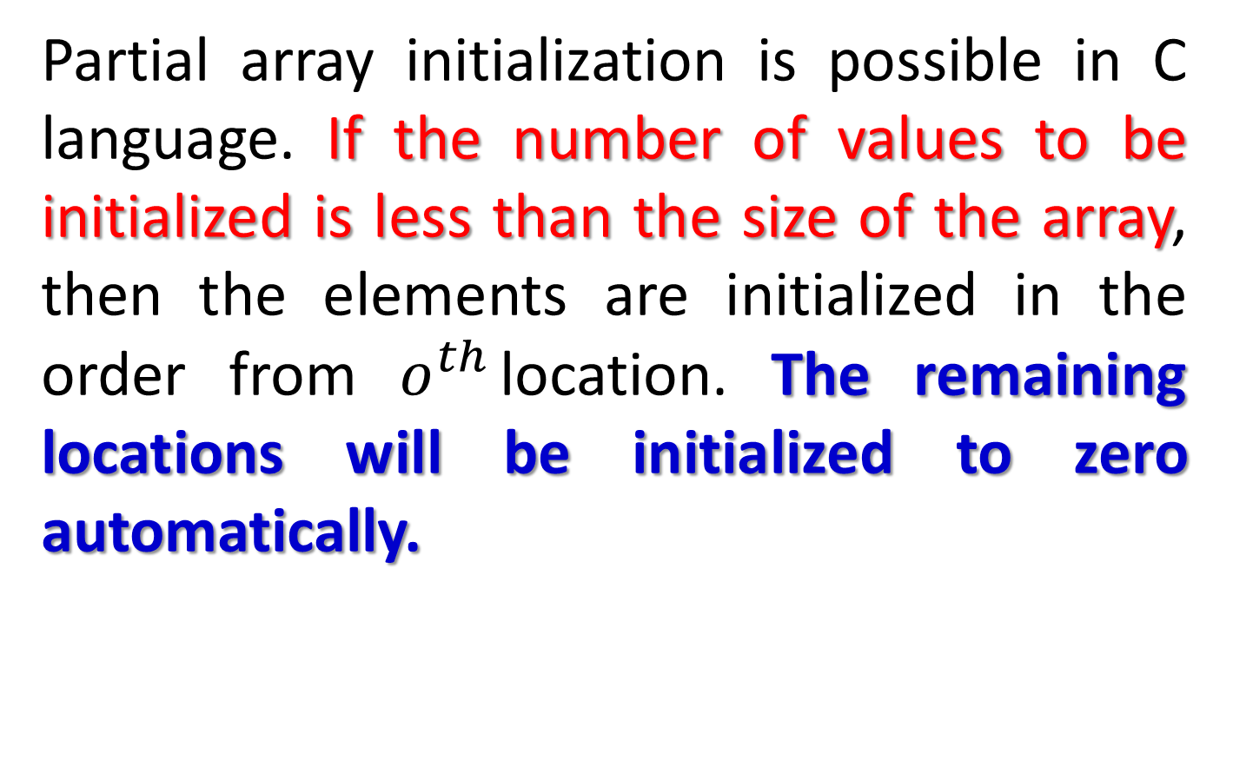
2 : Partial Array Initilization :
Partial array initialization is possible in C language. If the number of values to be initialized is less than the size of the array, then the elements are initialized in the order from $o^{th}$location. The remaining locations will be initialized to zero automatically.

Slide 23
2 : Partial Array Initilization :
Ex : Consider the partial initilization
int a[5]={10,15};
Eventhough compiler allocates 5 memory locations, using this declaration statement, the compiler initializes first two locations with 10 and 15, the next set of memory locations are automatically initialized to zero.

Slide 24
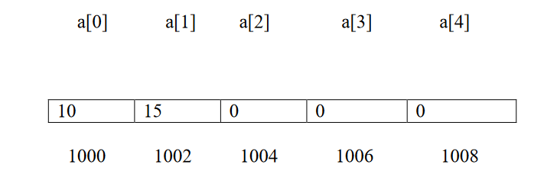
2 : Partial Array Initilization :
The array a is partial initialization as

Slide 25
2 : Partial Array Initilization :
How to access the elements of an array?
You can access elements of an array by indices/index. You can use array subscript (or index) to access any element stored in array. Subscript starts with 0, which means array_name[0] would be used to access first element in an array.
In general array_name[n-1] can be used to access nth element of an array. where n is any integer number.

Slide 26
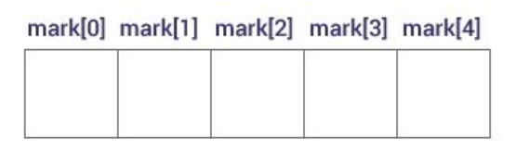
2 : Partial Array Initilization :
Example
float mark[5];
Suppose you declared an array mark as above. The first element is mark[0], second element is mark[1] and so on.

Slide 27
2 : Partial Array Initilization :
Few key notes:
Arrays have 0 as the first index not 1. In this example, mark[0]
If the size of an array is n, to access the last element, (n-1) index is used. In this example, mark[4]
Suppose the starting address of mark[0] is 2120d. Then, the next address, a[1], will be 2124d, address of a[2] will be 2128d and so on. It's because the size of a float is 4 bytes.

Slide 28
Input data into array
Code:
for (x=0; x<=19;x++)
{
printf("enter the integer number %d\n", x);
scanf("%d", &num[x]);
}

Slide 29
Reading out data from an array
For example you want to read and display array elements, you can do it just by using any loop.
Suppose array is mydata[20].
for (int i=0; i<20; i++)
{
printf("%d\n", mydata[x]);
}

Slide 30
Example
Exmaple
#include<stdio.h>
#include<conio.h>
void main()
{
int i;
int arr[]={2,3,4}; //Compile time array initialization
for(i=0 ; i<3 ; i++)
{
printf("%d\t",arr[i]);
}
getch();
}
Output
2 3 4

Slide 31
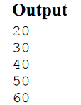
Example
#include <stdio.h>
#include <conio.h>
void main()
{
int i=0;
int marks[5]={20,30,40,50,60};//declaration and initialization of array
clrscr();
//traversal of array
for(i=0;i<5;i++)
{
printf("%d \n",marks[i]);
}
getch();
}

Slide 32
Runtime Array initialization
An array can also be initialized at runtime using scanf() function. This approach is usually used for initializing large array, or to initialize array with user specified values.
Example
#include<stdio.h>
#include<conio.h>
void main()
{
int arr[4];
int i, j;
printf("Enter array element");

Slide 33
Runtime Array initialization
for(i=0;i<4;i++)
{
scanf("%d",&arr[i]); //Run time array initialization
}
for(j=0;j<4;j++)
{
printf("%d\n",arr[j]);
}
getch();
}

Slide 34
NOTE
1. In 1-D arrays it is optional to specify the size of the array. If size is omitted during initialization then the compiler assumes the size of array equal to the number of initializers.
Example:.
int marks[]={10,2,0,23,4};
Here the size of array marks is initialized to 5

Slide 35
NOTE
2. We can’t copy the elements of one array to another array by simply assigning it.
Example:
int a[5]={9,8,7,6,5};
int b[5];
b=a; //not valid
we have to copy all the elements by using for loop.
for(a=i; i<5; i++)
b[i]=a[i];

Slide 36
Processing
For processing arrays we mostly use for loop. The total no. of passes is equal to the no. of elements present in the array and in each pass one element is processed.

Slide 37
Processing
Example:
#include<stdio.h>
main()
{
int a[3],i;
for(i=0;i<=2;i++) //Reading the array values
{
printf(“enter the elements”);
scanf(“%d”,&a[i]);
}

Slide 38
Processing
for(i=0;i<=2;i++) //display the array values
{
printf(“%d”,a[i]);
printf(“\n”);
}
}
This program reads and displays 3 elements of integer type.

Slide 39
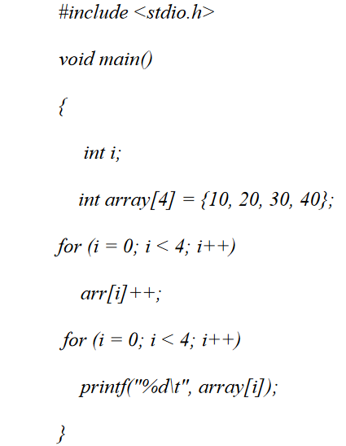
Example:1
C Program to Increment every Element of the Array by one & Print Incremented Array.

Slide 40
Example-2
C program to accept N numbers and arrange them in an ascending order
#include <stdio.h>
void main()
{
int i, j, a, n, number[30];
printf("Enter the value of N \n");
scanf("%d", &n);
printf("Enter the numbers \n");
for (i = 0; i < n; ++i)
scanf("%d", &number[i]);

Slide 41
for (i = 0; i < n; ++i)
{
for (j = i + 1; j < n; ++j)
{
if (number[i] > number[j])
{
a =number[i];
number[i] = number[j];
number[j] = a;
}
}
}

Slide 42
printf("The numbers arranged in ascending order are given below \n");
for (i = 0; i < n; ++i)
printf("%d\n", number[i]);
}

Slide 43
Two‐Dimensional Arrays
The two dimensional array in C language is represented in the form of rows and columns, also known as matrix. It is also known as array of arrays or list of arrays.
The two dimensional, three dimensional or other dimensional arrays are also known as multidimensional arrays.

Slide 44
Two‐Dimensional Arrays
Declaration of two dimensional Array
Syntax:
data_type array_name[rowsize][columnsize];
Rowsize specifies the no.of rows
Columnsize specifies the no.of columns.
Example:
int a[4][5];

Slide 45
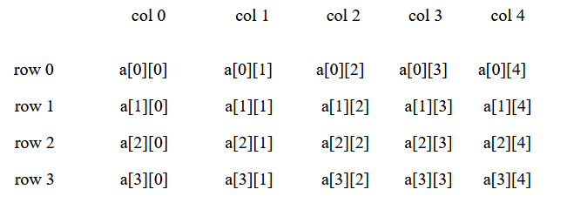
Two‐Dimensional Arrays
This is a 2-D array of 4 rows and 5 columns. Here the first element of the array is a[0][0] and last element of the array is a[3][4] and total no.of elements is 4*5=20.

Slide 46
Two‐Dimensional Arrays
Initialization:
2-D arrays can be initialized in a way similar to 1-D arrays.
Example:
int m[4][3]={1,2,3,4,5,6,7,8,9,10,11,12};

Slide 47
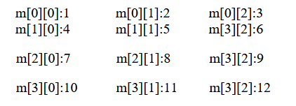
Two‐Dimensional Arrays
The values are assigned as follows:

Slide 48
Two‐Dimensional Arrays
The initialization of group of elements as follows:
int arr[4][3]={{1,2,3},{2,3,4},{3,4,5},{4,5,6}};

Slide 49
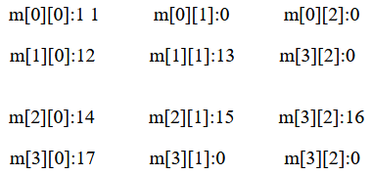
Two‐Dimensional Arrays
The initialization of group of elements as follows:
int m[4][3]={{11},{12,13},{14,15,16},{17}};
The values are assigned as:

Slide 50
Two‐Dimensional Arrays
Processing:
For processing of 2-D arrays we need two nested for loops. The outer loop indicates the rows and the inner loop indicates the columns.

Slide 51
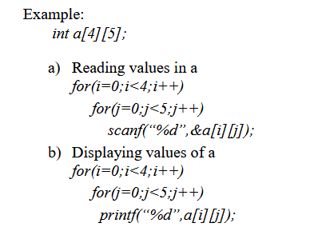
Two‐Dimensional Arrays
Processing:

Slide 52
Two‐Dimensional Arrays
Example 1:
Write a C program to find sum of two matrices

Slide 53
Two‐Dimensional Arrays
#include <stdio.h>
#include<conio.h>
void main()
{
float a[2][2], b[2][2], c[2][2];
int i,j;
clrscr();
printf("Enter the elements of 1st matrix\n");

Slide 54
Two‐Dimensional Arrays
for(i=0;i<2;I++)
{
for(j=0;j<2;j++)
{
scanf("%f",&a[i][j]);
}
printf("Enter the elements of 2nd matrix\n");
for(i=0;i<2;i++)
{
for(j=0;j<2;j++)
{
scanf("%f",&b[i][j]);
}
}

Slide 55
Two‐Dimensional Arrays
/* accessing corresponding elements of two arrays. */
for(i=0;i<2;i++)
{
for(j=0;j<2;j++)
{
c[i][j]=a[i][j]+b[i][j];
}
}

Slide 56
Two‐Dimensional Arrays
/* To display matrix sum in order. */
printf("\nSum Of Matrix:");
for(i=0;i<2;++i)
{
for(j=0;j<2;++j)
{
printf("%f", c[i][j]);
}
printf("\n");
}
getch();
}

Slide 57
Two‐Dimensional Arrays
Exercise 2: Program for multiplication of two matrices
Exercise 3: Program to find transpose of a matrix.

Slide 58
Thank you….

